Slide 1
CSC 502 WEB COMPUTING
Instructor: Bincy Ivin

Slide 2
JavaScript
JavaScript was introduced in 1995 as a way to add programs to web pages in the Netscape Navigator browser.
The language has since been adopted by all other major graphical web browsers. It has made modern web applications possible—applications with which you can interact directly without doing a page reload for every action.
JavaScript is also used in more traditional websites to provide various forms of interactivity and cleverness.

Slide 3
JavaScript
It is important to note that JavaScript has almost nothing to do with the programming language named Java.
The similar name was inspired by marketing considerations rather than good judgment.
When JavaScript was being introduced, the Java language was being heavily marketed and was gaining popularity.
Someone thought it was a good idea to try to ride along on this success. Now we are stuck with the name..

Slide 4
JavaScript
In the beginning, at the birth of computing, there were no programming languages. Programs looked something like this:
00110001 00000000 00000000
00110001 00000001 00000001
00110011 00000001 00000010
01010001 00001011 00000010
00100010 00000010 00001000
01000011 00000001 00000000
01000001 00000001 00000001
00010000 00000010 00000000
01100010 00000000 00000000
That is a program to add the numbers from 1 to 10 together and print out the result: 1 + 2 + ... + 10 = 55.

Slide 5
JavaScript
Here is the same program in JavaScript:
let total = 0, count = 1;
while (count <= 10) {
total += count;
count += 1;
}
console.log(total);
// → 55
console.log(sum(range(1, 10)));
// → 55

Slide 6
JavaScript
Numbers
In a JavaScript program, they are written as follows: 13
Use that in a program, and it will cause the bit pattern for the number 13 to come into existence inside the computer’s memory.
JavaScript uses a fixed number of bits, 64 of them, to store a single number value. There are only so many patterns you can make with 64 bits, which means that the number of different numbers that can be represented is limited.
Fractional numbers are written by using a dot: 9.81
For very big or very small numbers, you may also use scientific notation by adding an e (for exponent), followed by the exponent of the number.
2.998e8
That is 2.998 × 108 = 299,800,000.

Slide 7
JavaScript
Arithmetic:
Arithmetic operations such as addition or multiplication take two number values and produce a new number from them. Here is what they look like in JavaScript:
100 + 4 * 11
The + and * symbols are called operators. The first stands for addition, and the second stands for multiplication.
But as in mathematics, you can change this by wrapping the addition in parentheses.
(100 + 4) * 11

Slide 8
JavaScript
When operators appear together without parentheses, the order in which they are applied is determined by the precedence of the operators.
The example shows that multiplication comes before addition. The / operator has the same precedence as *. Likewise for + and -. When multiple operators with the same precedence appear next to each other, as in 1 - 2 + 1, they are applied left to right: (1 - 2) + 1.
The % symbol is used to represent the remainder operation. X % Y is the remainder of dividing X by Y. For example, 314 % 100 produces 14, and 144 % 12 gives 0. The remainder operator’s precedence is the same as that of multiplication and division. You’ll also often see this operator referred to as modulo.

Slide 9
JavaScript
Strings
The next basic data type is the string. Strings are used to represent text. They are written by enclosing their content in quotes.
`Down on the sea`
"Lie on the ocean"
'Float on the ocean'
You can use single quotes, double quotes, or backticks to mark strings, as long as the quotes at the start and the end of the string match.
Almost anything can be put between quotes, and JavaScript will make a string value out of it.Newlines (the characters you get when you press enter) can be included without escaping only when the string is quoted with backticks (`).

Slide 10
JavaScript
To include such characters in a string, the following notation is used: whenever a backslash (\) is found inside quoted text, it indicates that the character after it has a special meaning. This is called escaping the character. A quote that is preceded by a backslash will not end the string but be part of it. When an n character occurs after a backslash, it is interpreted as a newline. Similarly, a t after a backslash means a tab character. Take the following string:
"This is the first line\nAnd this is the second"
The actual text contained is this:
This is the first line
And this is the second

Slide 11
JavaScript
Strings cannot be divided, multiplied, or subtracted, but the + operator can be used on them. It does not add, but it concatenates—it glues two strings together. The following line will produce the string "concatenate":
"con" + "cat" + "e" + "nate"
Backtick-quoted strings, usually called template literals, can do a few more tricks. Apart from being able to span lines, they can also embed other values.
`half of 100 is ${100 / 2}`
When you write something inside ${} in a template literal, its result will be computed, converted to a string, and included at that position. The example produces “half of 100 is 50”.

Slide 12
JavaScript
Not all operators are symbols. Some are written as words. One example is the typeof operator, which produces a string value naming the type of the value you give it.
console.log(typeof 4.5)
// → number
console.log(typeof "x")
// → string
The other operators shown all operated on two values, but typeof takes only one. Operators that use two values are called binary operators, while those that take one are called unary operators. The minus operator can be used both as a binary operator and as a unary operator.
console.log(- (10 - 2))
// → -8

Slide 13
JavaScript
Boolean values
It is often useful to have a value that distinguishes between only two possibilities, like “yes” and “no” or “on” and “off”. For this purpose, JavaScript has a Boolean type, which has just two values, true and false, which are written as those words.
Comparison
Here is one way to produce Boolean values:
console.log(3 > 2)
// → true
console.log(3 < 2)
// → false

Slide 14
JavaScript
Strings can be compared in the same way.
console.log("Aardvark" < "Zoroaster")
// → true
The way strings are ordered is roughly alphabetic but not really what you’d expect to see in a dictionary: uppercase letters are always “less” than lowercase ones, so "Z" < "a", and nonalphabetic characters (!, -, and so on) are also included in the ordering. When comparing strings, JavaScript goes over the characters from left to right, comparing the Unicode codes one by one.

Slide 15
JavaScript
Logical operators
There are also some operations that can be applied to Boolean values themselves. JavaScript supports three logical operators: and, or, and not. These can be used to “reason” about Booleans.
The && operator represents logical and. It is a binary operator, and its result is true only if both the values given to it are true.
console.log(true && false)
// → false
console.log(true && true)
// → true

Slide 16
JavaScript
The || operator denotes logical or. It produces true if either of the values given to it is true.
console.log(false || true)
// → true
console.log(false || false)
// → false
ternary, operating on three values. It is written with a question mark and a colon, like this:
console.log(true ? 1 : 2);
// → 1
console.log(false ? 1 : 2);
// → 2

Slide 17
JavaScript
Automatic type conversion:
console.log(8 * null)
// → 0
console.log("5" - 1)
// → 4
console.log("5" + 1)
// → 51
console.log("five" * 2)
// → NaN
console.log(false == 0)
// → true

Slide 18
JavaScript
Bindings
How does a program keep an internal state? How does it remember things? To catch and hold values, JavaScript provides a thing called a binding, or variable:
let caught = 5 * 5;
That’s a second kind of statement. The special word (keyword) let indicates that this sentence is going to define a binding. It is followed by the name of the binding and, if we want to immediately give it a value, by an = operator and an expression.

Slide 19
JavaScript
let mood = "light";
console.log(mood);
// → light
mood = "dark";
console.log(mood);
// → dark
var name = "Ayda";
const greeting = "Hello ";
console.log(greeting + name);
// → Hello Ayda
A binding name may include dollar signs ($) or underscores (_) but no other punctuation or special characters.

Slide 20
JavaScript
Words with a special meaning, such as let, are keywords, and they may not be used as binding names. There are also a number of words that are “reserved for use” in future versions of JavaScript, which also can’t be used as binding names. The full list of keywords and reserved words is rather long.
break case catch class const continue debugger default delete do else enum export extends false finally for function if implements import interface in instanceof let new package private protected public return static super switch this throw true try typeof var void while with yield

Slide 21
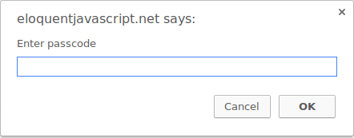
JavaScript
in a browser environment, the binding prompt holds a function that shows a little dialog box asking for user input. It is used like this:
prompt("Enter passcode");
A prompt dialog

Slide 22
JavaScript
Most JavaScript systems (including all modern web browsers and Node.js) provide a console.log function that writes out its arguments to some text output device. In browsers, the output lands in the JavaScript console. This part of the browser interface is hidden by default
let x = 30;
console.log("the value of x is", x);
// → the value of x is 30

Slide 23
JavaScript
Return values
the function Math.max takes any amount of number arguments and gives back the greatest.
console.log(Math.max(2, 4));
// → 4
When a function produces a value, it is said to return that value. Anything that produces a value is an expression in JavaScript, which means function calls can be used within larger expressions. Here a call to Math.min, which is the opposite of Math.max, is used as part of a plus expression:
console.log(Math.min(2, 4) + 100);
// → 102

Slide 24
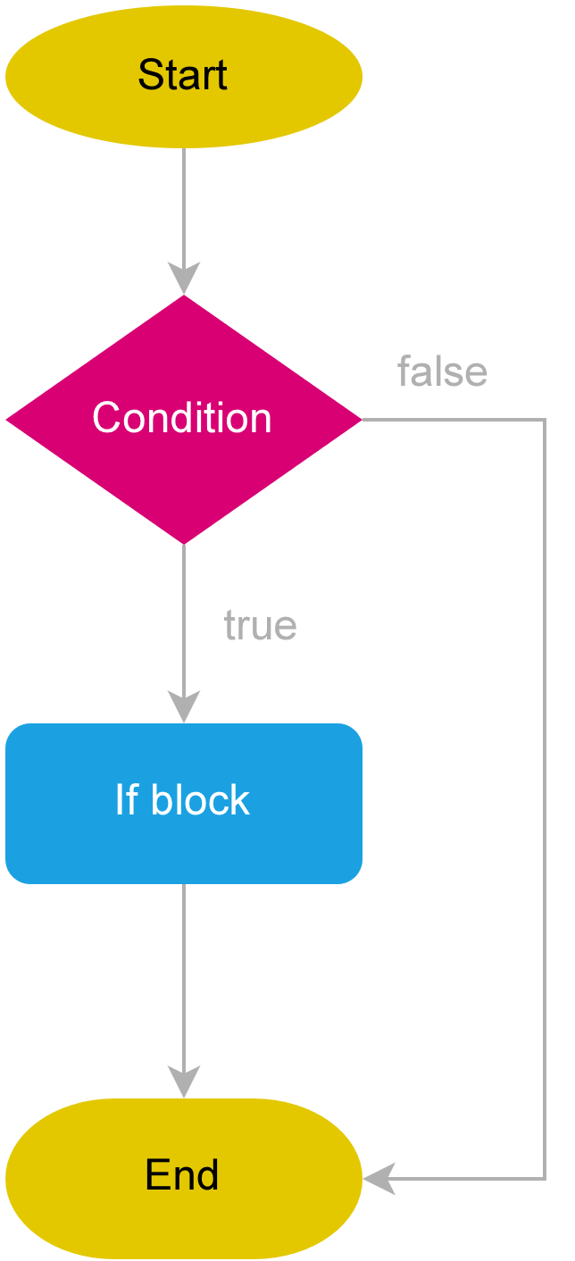
JavaScript
if( condition )
statement;

Slide 25
JavaScript
let age = 18;
if (age >= 18) {
console.log('You can sign up');
}
Output: You can sign up

Slide 26
JavaScript
Nested if statement:
let age = 16;
let state = 'CA';
if (state == 'CA') {
if (age >= 16) {
console.log('You can drive.');
}
}
Output:
You can drive.

Slide 27
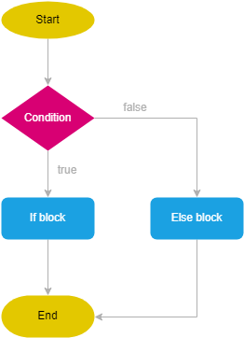
JavaScript
if( condition ) {
// ...
} else {
// ...
}

Slide 28
JavaScript
let age = 18;
if (age >= 18) {
console.log('You can sign up.');
} else {
console.log('You must be at least 18 to sign up.');
}

Slide 29
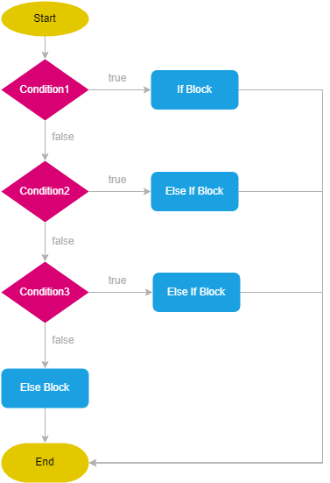
JavaScript
if (condition1) {
// ...
} else if (condition2) {
// ...
} else if (condition3) {
//...
} else {
//...
}

Slide 30
JavaScript
let month = 2;
let monthName;
if (month == 1) {
monthName = 'Jan';
} else if (month == 2) {
monthName = 'Feb';
} else if (month == 3) {
monthName = 'Mar';
} else if (month == 4) {
monthName = 'Apr';
} else {
monthName = 'Invalid month';
}
console.log(monthName);

Slide 31
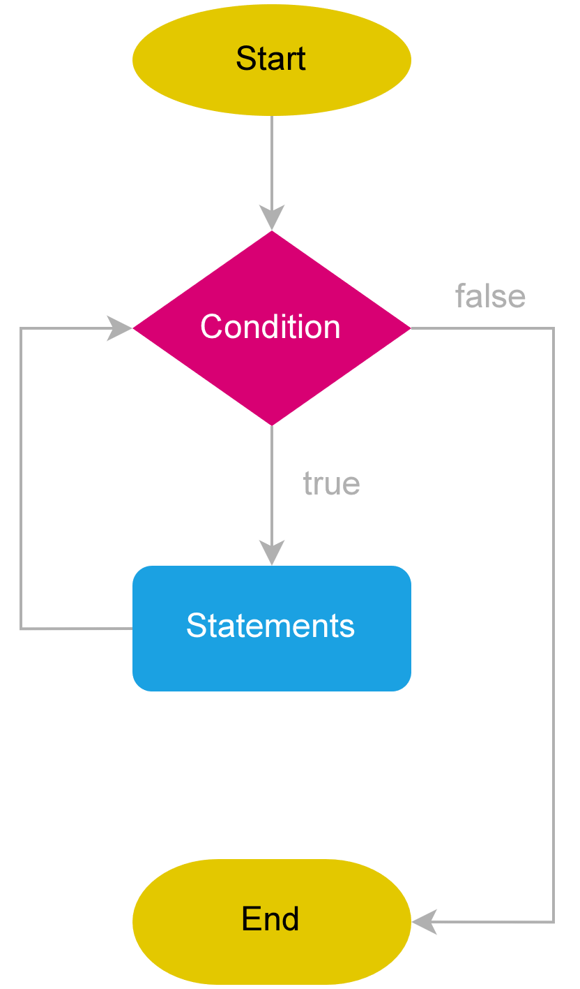
JavaScript
while and do loops
while (expression) {
// statement
}
let count = 1;
while (count < 10) {
console.log(count);
count +=2;
}
Output:1 3 5 7 9

Slide 32
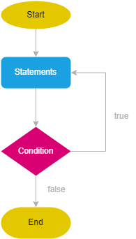
JavaScript
do {
statement;
} while(expression);
let count = 0;
do {
console.log(count);
count++;
} while (count < 5)
Output: 0 1 2 3 4

Slide 33
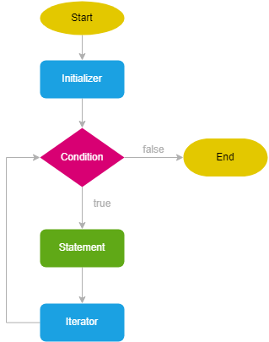
JavaScript
for loops
for (initializer; condition; iterator) {
// statements
}
for (let i = 1; i < 5; i++) {
console.log(i);
}
Output:
1
2
3
4

Slide 34
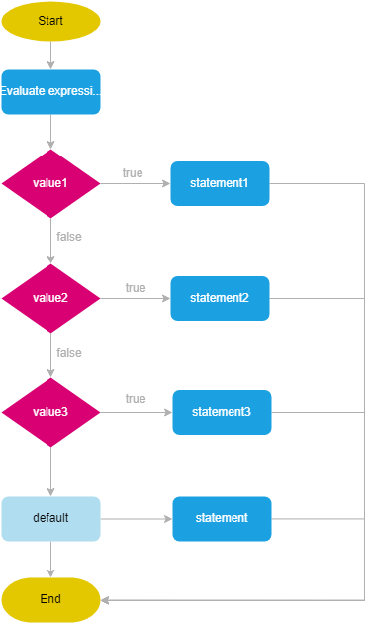
JavaScript
switch (expression) {
case value1:
statement1;
break;
case value2:
statement2;
break;
case value3:
statement3;
break;
default:
statement;
}

Slide 35
JavaScript
let day = 3;
let dayName;
switch (day) {
case 1:
dayName = 'Sunday';
break;
case 2:
dayName = 'Monday';
break;
case 3:
dayName = 'Tuesday';
break;
default:
dayName = 'Invalid day';
}
console.log(dayName); // Tuesday

Slide 36
Comments
A // comment goes only to the end of the line. A section of text between /* and */ will be ignored in its entirety, regardless of whether it contains line breaks. This is useful for adding blocks of information about a file or a chunk of program.
/*
I first found this number scrawled on the back of an old
notebook. Since then, it has often dropped by, showing up in
phone numbers and the serial numbers of products that I've
bought. It obviously likes me, so I've decided to keep it.
*/

Slide 37
Functions
In JavaScript, a variable has two types of scope:
Global Scope
Local Scope
Global Scope
A variable declared at the top of a program or outside of a function is considered a global scope variable.

Slide 38
Objects
JavaScript object is a non-primitive data-type that allows you to store multiple collections of data.

Slide 39
Objects
JavaScript Object Declaration
The syntax to declare an object is:
const object_name = {
key1: value1,
key2: value2
}
const ves = {
name: 'VESIT',
address: 'chembur'
}
console.log(typeof person);

Slide 40
Accessing Object Properties
1. Using dot Notation
const ves = {
name: 'VESIT',
address: 'chembur'
}
console.log(ves.name);
2. Using bracket Notation
const ves = {
name: 'VESIT',
address: 'chembur'
}
console.log(ves[‘name’]);

Slide 41
Object
JavaScript Nested Objects
const ves = {
name: 'VESIT',
address: 'chembur',
phone: 4563728282
branch: {
name: 'AIDS',
strength: 70,
}
}
console.log(ves.branch.name);

Slide 42
Object
JavaScript Object Methods
const ves = {
name: 'VESIT',
address: 'chembur',
phone: 4563728282
branch: {
name: 'AIDS',
strength: 70,
}
greeting: function () {
console.log("welcome to VESIT”);
}
}
vesit.greeting();

Slide 43
JavaScript this Keyword
To access a property of an object from within a method of the same object, you need to use the this keyword.
const ves = {
name: 'VESIT',
address: 'chembur',
phone: 4563728282,
types: ['mca','mba','pharmacy'],
branch: {
name: 'AIDS',
strength: 70
}
greet: function () {
console.log("welcome to"+ " " + this.name);
}
ves.greet();

Slide 44
JavaScript this Keyword
However, the function inside of an object can access it's variable in a similar way as a normal function would. For example,
const ves = {
name: 'VESIT',
address: 'chembur',
phone: 4563728282,
types: ['mca','mba','pharmacy'],
branch: {
name: 'AIDS',
strength: 70,
greeting: function () {
a= 'aids';
console.log("welcome to"+ " " + a);
}
},
greet: function () {
console.log("welcome to"+ " " + this.name);
}
}
ves.greet();
ves.branch.greeting();

Slide 45
JavaScript Constructor Function
A constructor is a special method that is used to initialize objects. The constructor is called when an object of a class is created. It can be used to set initial values for object attributes.
constructor is a block of codes similar to the method. It is called when an instance of the class is created. At the time of calling the constructor, memory for the object is allocated in the memory. It is a special type of method which is used to initialize the object. Every time an object is created using the new() keyword, at least one constructor is called.
How Constructors are Different From Methods ?
Constructors must have the same name as the class within which it is defined while it is not necessary for the method.
Constructors do not return any type while method(s) have the return type or void if does not return any value.
Constructors are called only once at the time of Object creation while method(s) can be called any number of times.

Slide 46
JavaScript Constructor Function
What Happens When A Constructor Gets Called?
When a constructor gets invoked in JavaScript, the following sequence of operations take place:
A new empty object gets created.
The this keyword begins to refer to the new object and it becomes the current instance object.
The new object is then returned as the return value of the constructor.

Slide 47
JavaScript Constructor Function
Main() {
System.out.println("Constructor Called:");
name = "hello";
}
Main obj = new Main();
System.out.println("The name is " + obj.name);

Slide 48
JavaScript Constructor Function
// constructor function
function Person () {
this.name = 'John',
}
// create object
const person1 = new Person();
// access properties
console.log(person1.name); // John
In a constructor function this does not have a value. It is a substitute for the new object. The value of this will become the new object when a new object is created

Slide 49
JavaScript Constructor Function
The examples from the previous chapters are limited. They only create single objects.
Sometimes we need a "blueprint" for creating many objects of the same "type".
The way to create an "object type", is to use an object constructor function.
In the example above, function Person() is an object constructor function.
Objects of the same type are created by calling the constructor function with the new keyword:

Slide 50
JavaScript Constructor Function
function Person (person_name, person_age, person_gender) {
this.name = person_name,
this.age = person_age,
this.gender = person_gender,
this.greet = function () {
return ('Hi' + ' ' + this.name);
}
}
const person1 = new Person('John', 23, 'male');
const person2 = new Person('Sam', 25, 'female');
console.log(person1.name); // "John"
console.log(person2.name); // "Sam"

Slide 51
JavaScript Constructor Function
Create Objects: Constructor Function Vs Object Literal
Object Literal is generally used to create a single object. The constructor function is useful if you want to create multiple objects. For example,
// using object literal
let person = {
name: 'Sam'
}
// using constructor function
function Person () {
this.name = 'Sam'
}
let person1 = new Person();
let person2 = new Person();

Slide 52
JavaScript Constructor Function
Each object created from the constructor function is unique. You can have the same properties as the constructor function or add a new property to one particular object. For example,
// using constructor function
function Person () {
this.name = 'Sam'
}
let person1 = new Person();
let person2 = new Person();
// adding new property to person1
person1.age = 20;
Now this age property is unique to person1 object and is not available to person2 object.

Slide 53
JavaScript Constructor Function
Each object created from the constructor function is unique. You can have the same properties as the constructor function or add a new property to one particular object. For example,
// using constructor function
function Person () {
this.name = 'Sam'
}
let person1 = new Person();
let person2 = new Person();
// adding new property to person1
person1.age = 20;
Now this age property is unique to person1 object and is not available to person2 object.

Slide 54
JavaScript Constructor Function
However, if an object is created with an object literal, and if a variable is defined with that object value, any changes in variable value will change the original object. For example,
// using object lateral
let person = {
name: 'Sam'
}
console.log(person.name); // Sam
let student = person;
// changes the property of an object
student.name = 'John';
// changes the origins object property
console.log(person.name); // John
When an object is created with an object literal, any object variable derived from that object will act as a clone of the original object. Hence, any change you make in one object will also reflect in the other object.

Slide 55
JavaScript Constructor Function
Note: In JavaScript, the keyword class was introduced in ES6 (ES2015) that also allows us to create objects. Classes are similar to constructor functions in JavaScript. To learn more, visit JavaScript Classes.

Slide 56
JavaScript
Accessor Property
In JavaScript, accessor properties are methods that get or set the value of an object. For that, we use these two keywords:
get - to define a getter method to get the property value
set - to define a setter method to set the property value
JavaScript Getter
In JavaScript, getter methods are used to access the properties of an object. For example,

Slide 57
JavaScript
const student = {
// data property
firstName: 'Monica',
// accessor property(getter)
get getName() {
return this.firstName;
}
};
// accessing data property
console.log(student.firstName); // Monica
// accessing getter methods
console.log(student.getName); // Monica
// trying to access as a method
console.log(student.getName()); // error

Slide 58
JavaScript
In the above program, a getter method getName() is created to access the property of an object.
get getName() {
return this.firstName;
}
Note: To create a getter method, the get keyword is used.
And also when accessing the value, we access the value as a property.
student.getName;
When you try to access the value as a method, an error occurs.
console.log(student.getName()); // error

Slide 59
JavaScript
JavaScript Setter
In JavaScript, setter methods are used to change the values of an object. For example,
const student = {
firstName: 'Monica',
//accessor property(setter)
set changeName(newName) {
this.firstName = newName;
}
};
console.log(student.firstName); // Monica
// change(set) object property using a setter
student.changeName = 'Sarah';
console.log(student.firstName); // Sarah

Slide 60
JavaScript
In the above example, the setter method is used to change the value of an object.
set changeName(newName) {
this.firstName = newName;
}
Note: To create a setter method, the set keyword is used.
As shown in the above program, the value of firstName is Monica.
Then the value is changed to Sarah.
student.changeName = 'Sarah';
Note: Setter must have exactly one formal parameter.

Slide 61
JavaScript
ECMAScript is a trademarked scripting language specification that is defined by ECMA International. It was created to standardize JavaScript. The ES scripting language has many implementations, and the popular one is JavaScript. Generally, ECMAScript is used for client-side scripting of the World Wide Web.
ES5 is an abbreviation of ECMAScript 5 and also known as ECMAScript 2009. The sixth edition of the ECMAScript standard is ES6 or ECMAScript 6. It is also known as ECMAScript 2015. ES6 is a major enhancement in the JavaScript language that allows us to write programs for complex applications.
Although ES5 and ES6 have some similarities in their nature, there are also so many differences between them.

Slide 62
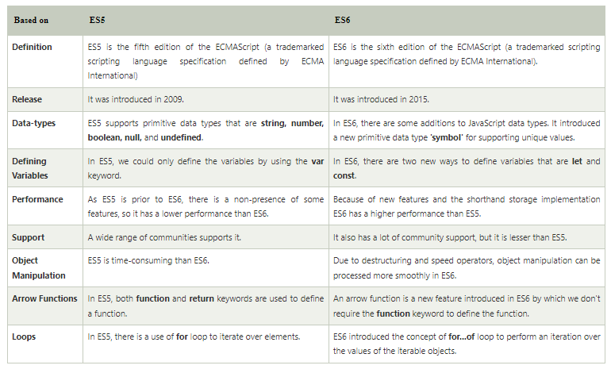
JavaScript

Slide 63
JavaScript Arrow Function
Arrow function is one of the features introduced in the ES6 version of JavaScript. It allows you to create functions in a cleaner way compared to regular functions. For example,
This function
// function expression
let x = function(x, y) {
return x * y;
}
can be written as
// using arrow functions
let x = (x, y) => x * y;
using an arrow function.

Slide 64
JavaScript Arrow Function
Arrow Function Syntax
The syntax of the arrow function is:
let myFunction = (arg1, arg2, ...argN) => {
statement(s)
}
Here,
myFunction is the name of the function
arg1, arg2, ...argN are the function arguments
statement(s) is the function body
If the body has single statement or expression, you can write arrow function as:
let myFunction = (arg1, arg2, ...argN) => expression

Slide 65
JavaScript Arrow Function
Example 1: Arrow Function with No Argument
If a function doesn't take any argument, then you should use empty parentheses. For example,
let greet = () => console.log('Hello');
greet(); // Hello
Example 2: Arrow Function with One Argument
If a function has only one argument, you can omit the parentheses. For example,
let greet = x => console.log(x);
greet('Hello'); // Hello

Slide 66
JavaScript Arrow Function
Multiline Arrow Functions
If a function body has multiple statements, you need to put them inside curly brackets {}. For example,
let sum = (a, b) => {
let result = a + b;
return result;
}
let result1 = sum(5,7);
console.log(result1); // 12

Slide 67
JavaScript for... of Loop
In JavaScript, there are three ways we can use a for loop.
JavaScript for loop
JavaScript for...in loop
JavaScript for...of loop
The for...of loop was introduced in the later versions of JavaScript ES6.
The for..of loop in JavaScript allows you to iterate over iterable objects (arrays, sets, maps, strings etc).

Slide 68
JavaScript for... of Loop
The for…in loop
The for…in loop is similar to for loop, which iterates through the properties of an object, i.e., when you require to visit the properties or keys of the object, then you can use for…in loop.
for (variable_name in object_name) //Here in is the keyword
{
// statement or block to execute
}
In every iteration, one property from the object is assigned to the name of the variable, and this loop continues till all of the object properties get covered.

Slide 69
JavaScript for... of Loop
function Mobile(model_no){
this.Model = model_no;
this.Color = 'White';
this.RAM = '4GB';
}
var Samsung = new Mobile("Galaxy");
for(var props in Samsung)
{
console.log(props+ " : " +Samsung[props]);
}
Model : Galaxy
Color : White
RAM : 4GB

Slide 70
JavaScript for... of Loop
If you pass the function in the properties of the object then this loop will give you the complete function in the output. You can it's illustration in the following code:

Slide 71
JavaScript for... of Loop
function Mobile(model_no){
this.Model = model_no;
this.Color = 'White';
this.RAM = '4GB';
this.Price = function price()
{
console.log(this.model + "Price = Rs. 3300");
}
}
var Samsung = new Mobile("Galaxy");
for(var props in Samsung)
{
console.log(props+ " : " +Samsung[props]);
}
Model : Galaxy
Color : White
RAM : 4GB
Price : function price()
{
console.log(this.model + "Price = Rs. 3300");
}

Slide 72
JavaScript for... of Loop
The for…of loop
Unlike the object literals, this loop is used to iterate the iterables (arrays, string, etc.).
Syntax
for(variable_name of object_name) // Here of is a keyword
{
//statement or block to execute
}
In every iteration, one property from the iterables gets assigned to the variable_name, and the loop continues till the end of the iteration.

Slide 73
JavaScript for... of Loop
var fruits = ['Apple', 'Banana', 'Mango', 'Orange'];
for(let value of fruits)
{
console.log(value);
}
Output
Apple
Banana
Mango
Orange

Slide 74
JavaScript Classes
Classes are one of the features introduced in the ES6 version of JavaScript.
A class is a blueprint for the object. You can create an object from the class.
You can think of the class as a sketch (prototype) of a house. It contains all the details about the floors, doors, windows, etc. Based on these descriptions, you build the house. House is the object.
Since many houses can be made from the same description, we can create many objects from a class.
Before ES6, it was hard to create a class in JavaScript. But in ES6, we can create the class by using the class keyword. We can include classes in our code either by class expression or by using a class declaration.
A class definition can only include constructors and functions. These components are together called as the data members of a class. The classes contain constructors that allocates the memory to the objects of a class. Classes contain functions that are responsible for performing the actions to the objects.

Slide 75
JavaScript Classes
class Student {
constructor(name, age) {
this.n = name;
this.a = age;
}
stu() {
console.log("The Name of the student is: ", this.n)
console.log("The Age of the student is: ",this. a)
}
}
let stuObj = new Student('Peter',20);
stuObj.stu();

Slide 76
JavaScript Classes
Hoisting
A class should be defined before using it. Unlike functions and other JavaScript declarations, the class is not hoisted. For example,
// accessing class
const p = new Person(); // ReferenceError
// defining class
class Person {
constructor(name) {
this.name = name;
}
}

Slide 77
JavaScript Classes
Note: JavaScript class is a special type of function. And the typeof operator returns function for a class.
For example,
class Person {}
console.log(typeof Person); // function

Slide 78
JavaScript Class Inheritance
Class Inheritance
Inheritance enables you to define a class that takes all the functionality from a parent class and allows you to add more.
Using class inheritance, a class can inherit all the methods and properties of another class.
Inheritance is a useful feature that allows code reusability.
To use class inheritance, you use the extends keyword. For example,

Slide 79
JavaScript Class Inheritance
Before the ES6, the implementation of inheritance required several steps. But ES6 simplified the implementation of inheritance by using the extends and super keyword.
Inheritance is the ability to create new entities from an existing one. The class that is extended for creating newer classes is referred to as superclass/parent class, while the newly created classes are called subclass/child class.
A class can be inherited from another class by using the 'extends' keyword. Except for the constructors from the parent class, child class inherits all properties and methods.

Slide 80
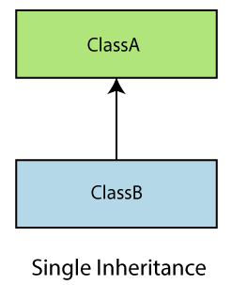
JavaScript Class Inheritance
Types of inheritance
Inheritance can be categorized as Single-level inheritance, Multiple inheritance, and Multi-level inheritance. Multiple inheritance is not supported in ES6.
Single-level Inheritance
It is defined as the inheritance in which a derived class can only be inherited from only one base class. It allows a derived class to inherit the behavior and properties of a base class, which enables the reusability of code as well as adding the new features to the existing code. It makes the code less repetitive.

Slide 81
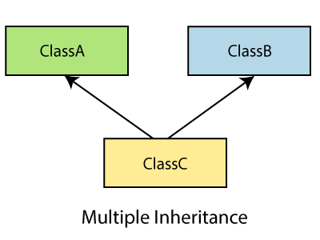
JavaScript Class Inheritance
Multiple Inheritance
In multiple inheritance, a class can be inherited from several classes. It is not supported in ES6.

Slide 82
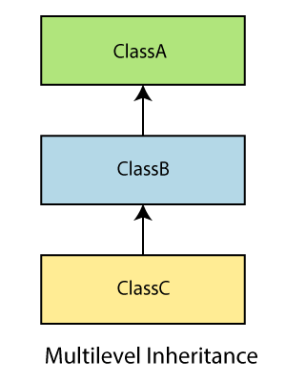
JavaScript Class Inheritance
Multi-level Inheritance
In Multi-level inheritance, a derived class is created from another derived class. Thus, a multi-level inheritance has more than one parent class.

Slide 83
JavaScript Class Inheritance
'use strict'
class Student {
constructor(a) {
this.name = a;
}
}
class User extends Student {
show() {
console.log("The name of the student is: "+this.name)
}
}
var obj = new User('Sahil');
obj.show()
In the above example, we have declared a class student. By using the extends keyword, we can create a new class User that shares the same characteristics as its parent class Student. So, we can see that there is an inheritance relationship between these classes.
Output
The name of the student is: Sahil

Slide 84
JavaScript Class Inheritance
class Animal{
eat(){ console.log("eating..."); }}
class Dog extends Animal{
bark(){ console.log("barking..."); }}
class BabyDog extends Dog{
weep(){console.log("weeping..."); }}
var d=new BabyDog();
d.eat();
d.bark();
d.weep();
eating...
barking...
weeping...

Slide 85
JavaScript Class Inheritance
The super keyword
It allows the child class to invoke the properties, methods, and constructors of the immediate parent class. It is introduced in ECMAScript 2015 or ES6. The super.prop and super[expr] expressions are readable in the definition of any method in both object literals and classes.
Syntax
super(arguments);
Example
In this example, the characteristics of the parent class have been extended to its child class. Both classes have their unique properties. Here, we are using the super keyword to access the property from parent class to the child class.

Slide 86
JavaScript Class Inheritance
class Car {
constructor() {
console.log('This is a car')
}
}
const myCar = new Car() //'This is a car'
class Tesla extends Car {
constructor() {
super()
console.log('This is a Tesla')
}
}
const myCar = new Tesla()
'This is a car'
'This is a Tesla'

Slide 87
JavaScript Class Inheritance
class Parent {
show() {
console.log("It is the show() method from the parent class");
}
}
class Child extends Parent {
show() {
super.show();
console.log("It is the show() method from the child class");
}
}
var obj = new Child();
obj.show();
It is the show() method from the parent class
It is the show() method from the child class

Slide 88
JavaScript Iterators and Iterables
JavaScript Iterables and Iterators
JavaScript provides a protocol to iterate over data structures. This protocol defines how these data structures are iterated over using the for...of loop.
The concept of the protocol can be split into:
iterable
iterator
The iterable protocol mentions that an iterable should have the Symbol.iterator key.
JavaScript Iterables
The data structures that have the Symbol.iterator() method are called iterables. For example, Arrays, Strings, Sets, etc.
JavaScript Iterators
An iterator is an object that is returned by the Symbol.iterator() method.
The iterator protocol provides the next() method to access each element of the iterable (data structure) one at a time.

Slide 89
JavaScript Iterators and Iterables
Let's look at an example of iterables having Symbol.Iterator()
const arr = [1, 2 ,3];
// calling the Symbol.iterator() method
const arrIterator = arr[Symbol.iterator]();
// gives Array Iterator
console.log(arrIterator);
const str = 'hello';
// calling the Symbol.iterator() method
const strIterator = str[Symbol.iterator]();
// gives String Iterator
console.log(strIterator);
Output
Array Iterator {}
StringIterator {}
Here, calling the Symbol.iterator() method of both the array and string returns their respective iterators.

Slide 90
JavaScript Iterators and Iterables
Iterate Through Iterables
You can use the for...of loop to iterate through these iterable objects. You can iterate through the Symbol.iterator() method like this:
const number = [ 1, 2, 3];
for (let n of number[Symbol.iterator]()) {
console.log(n);
}
Output
1
2
3

Slide 91
JavaScript Iterators and Iterables
Or you can simply iterate through the array like this:
const number = [ 1, 2, 3];
for (let n of number) {
console.log(n);
}
Here, the iterator allows the for...of loop to iterate over an array and return each value.

Slide 92
JavaScript Iterators and Iterables
JavaScript next() Method
The iterator object has a next() method that returns the next item in the sequence.
The next() method contains two properties: value and done.
value
The value property can be of any data type and represents the current value in the sequence.
done
The done property is a boolean value that indicates whether the iteration is complete or not. If the iteration is incomplete, the done property is set to false, else it is set to true.

Slide 93
JavaScript Iterators and Iterables
const arr = ['h', 'e', 'l', 'l', 'o'];
let arrIterator = arr[Symbol.iterator]();
console.log(arrIterator.next()); // {value: "h", done: false}
console.log(arrIterator.next()); // {value: "e", done: false}
console.log(arrIterator.next()); // {value: "l", done: false}
console.log(arrIterator.next()); // {value: "l", done: false}
console.log(arrIterator.next()); // {value: "o", done: false}
console.log(arrIterator.next()); // {value: undefined, done: true}
You can call next() repeatedly to iterate over an arrIterator object.
The next() method returns an object with two properties: value and done.
When the next() method reaches the end of the sequence, then the done property is set to false.

Slide 94
JavaScript Iterators and Iterables
const arr = ['h', 'e', 'l', 'l', 'o'];
for (let i of arr) {
console.log(i);
}
h
e
l
l
o
The for...of loop does exactly the same as the program above.
The for...of loop keeps calling the next() method on the iterator. Once it reaches done:true, the for...of loop terminates.

Slide 95
JavaScript Iterators and Iterables
User Defined Iterator
You can also create your own iterator and call next() to access the next element. For example,
function displayElements(arr) {
// to update the iteration
let n = 0;
return {
// implementing the next() function
next() {
if(n < arr.length) {
return {
value: arr[n++],
done: false}}

Slide 96
JavaScript Iterators and Iterables
return {
value: undefined,
done: true}}}}
const arr = ['h', 'e', 'l', 'l', 'o'];
const arrIterator = displayElements(arr);
console.log(arrIterator.next());
console.log(arrIterator.next());
console.log(arrIterator.next());
console.log(arrIterator.next());
console.log(arrIterator.next());
console.log(arrIterator.next());

Slide 97
JavaScript Iterators and Iterables
Output
{value: "h", done: false}
{value: "e", done: false}
{value: "l", done: false}
{value: "l", done: false}
{value: "o", done: false}
{value: undefined, done: true}
In the above program, we have created our own iterator. The displayElements() function returns value and done property.
Each time the next() method is called, the function gets executed once and displays the value of an array.
Finally, when all the elements of an array are exhausted, the done property is set to true, with value as undefined.

Slide 98
JavaScript Generators
JavaScript Generators
In this tutorial, you will learn about JavaScript generators with the help of examples.
In JavaScript, generators provide a new way to work with functions and iterators.
Using a generator,
you can stop the execution of a function from anywhere inside the function
and continue executing code from a halted position

Slide 99
JavaScript Generators
Create JavaScript Generators
To create a generator, you need to first define a generator function with function* symbol. The objects of generator functions are called generators.
// define a generator function
function* generator_function() {
... .. ...
}
// creating a generator
const generator_obj = generator_function();
Note: The generator function is denoted by *. You can either use function* generatorFunc() {...} or function *generatorFunc(){...} to create them.

Slide 100
JavaScript Generators
Using yield to Pause Execution
As mentioned above, you can pause the execution of a generator function without executing the whole function body. For that, we use the yield keyword. For example,
// generator function
function* generatorFunc() {
console.log("1. code before the first yield");
yield 100;
console.log("2. code before the second yield");
yield 200;
}
// returns generator object
const generator = generatorFunc();
console.log(generator.next());

Slide 101
JavaScript Generators
Output
1. code before the first yield
{value: 100, done: false}
Here,
A generator object named generator is created.
When generator.next() is called, the code up to the first yield is executed. When yield is encountered, the program returns the value and pauses the generator function.
Note: You need to assign generator objects to a variable before you use it.

Slide 102
JavaScript Generators
Working of multiple yield Statements
The yield expression returns a value. However, unlike the return statement, it doesn't terminate the program. That's why you can continue executing code from the last yielded position. For example,
function* generatorFunc() {
console.log("1. code before first yield");
yield 100;
console.log("2. code before the second yield");
yield 200;
console.log("3. code after the second yield");
}
const generator = generatorFunc();
console.log(generator.next());
console.log(generator.next());
console.log(generator.next());

Slide 103
Browser Object Model
he Browser Object Model (BOM) is used to interact with the browser.
The default object of browser is window means you can call all the functions of window by specifying window or directly. For example:
window.alert("hello javatpoint");
is same as:
alert("hello javatpoint");
You can use a lot of properties (other objects) defined underneath the window object like document, history, screen, navigator, location, innerHeight, innerWidth,

Slide 104
Browser Object Model
Window Object
The window object represents a window in browser. An object of window is created automatically by the browser.
Window is the object of browser, it is not the object of javascript. The javascript objects are string, array, date etc.

Slide 105
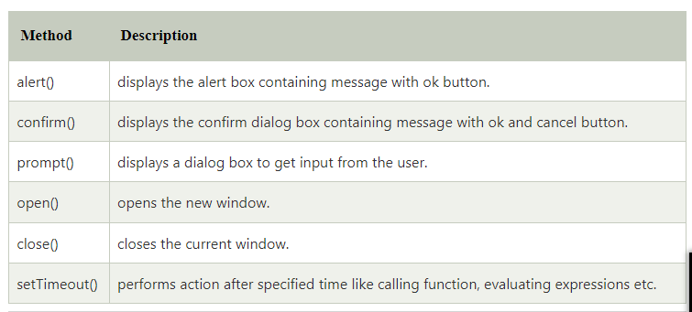
Browser Object Model
Methods of window object
The important methods of window object are as follows:

Slide 106
Browser Object Model
JavaScript History Object
The JavaScript history object represents an array of URLs visited by the user. By using this object, you can load previous, forward or any particular page.
The history object is the window property, so it can be accessed by:
window.history
Or,
history

Slide 107
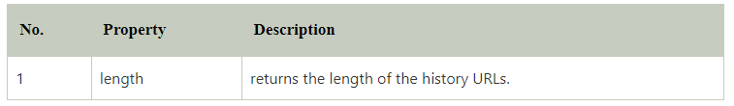
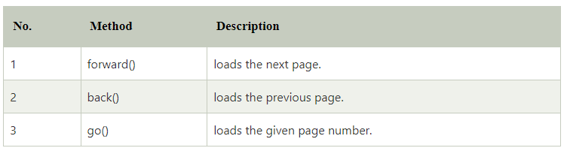
Browser Object Model
Property of JavaScript history object
There are only 1 property of history object.
Methods of JavaScript history object
There are only 3 methods of history object.

Slide 108
Browser Object Model
JavaScript Navigator Object
The JavaScript navigator object is used for browser detection. It can be used to get browser information such as appName, appCodeName, userAgent etc.
The navigator object is the window property, so it can be accessed by:
window.navigator
Or,
navigator

Slide 109
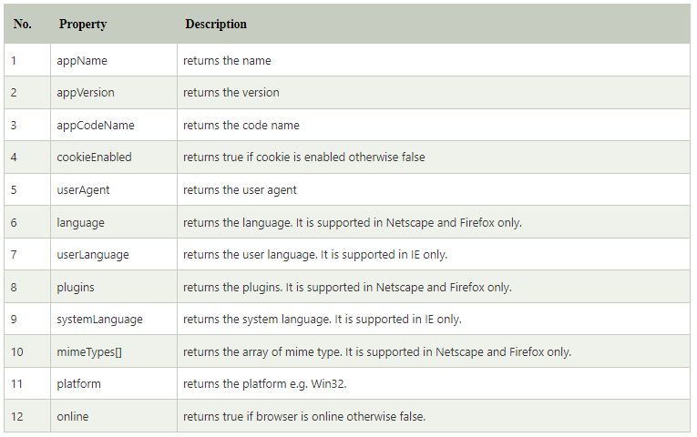
Browser Object Model
Property of JavaScript navigator object
There are many properties of navigator object that returns information of the browser.

Slide 110
Browser Object Model
Property of JavaScript navigator object
There are many properties of navigator object that returns information of the browser.

Slide 111
Browser Object Model
The JavaScript screen object holds information of browser screen. It can be used to display screen width, height, colorDepth, pixelDepth etc.
The navigator object is the window property, so it can be accessed by:
window.screen
Or,
screen

Slide 112
Browser Object Model
The JavaScript screen object holds information of browser screen. It can be used to display screen width, height, colorDepth, pixelDepth etc.
The navigator object is the window property, so it can be accessed by:
window.screen
Or,
screen

Slide 113
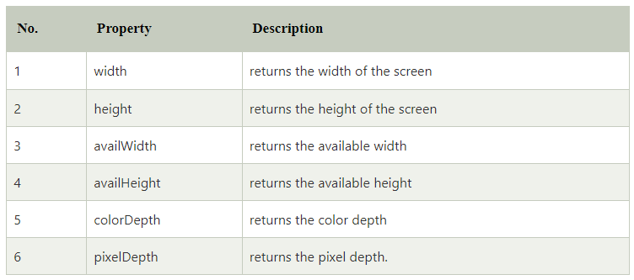
Browser Object Model
There are many properties of screen object that returns information of the browser.

Slide 114
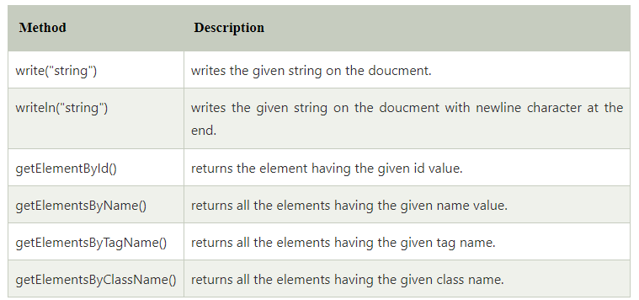
Document Object Model
Properties of document object

Slide 115
JavaScript Form Validation
It is important to validate the form submitted by the user because it can have inappropriate values. So, validation is must to authenticate user.
JavaScript provides facility to validate the form on the client-side so data processing will be faster than server-side validation. Most of the web developers prefer JavaScript form validation.
Through JavaScript, we can validate name, password, email, date, mobile numbers and more fields.
Basic Validation − First of all, the form must be checked to make sure all the mandatory fields are filled in. It would require just a loop through each field in the form and check for data.
Data Format Validation − Secondly, the data that is entered must be checked for correct form and value. Your code must include appropriate logic to test correctness of data.

Slide 116
JavaScript Cookies
A cookie is an amount of information that persists between a server-side and a client-side. A web browser stores this information at the time of browsing.
A cookie contains the information as a string generally in the form of a name-value pair separated by semi-colons. It maintains the state of a user and remembers the user's information among all the web pages.

Slide 117
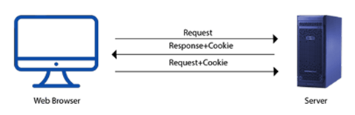
JavaScript Cookies
How Cookies Works?
When a user sends a request to the server, then each of that request is treated as a new request sent by the different user.
So, to recognize the old user, we need to add the cookie with the response from the server. browser at the client-side.
Now, whenever a user sends a request to the server, the cookie is added with that request automatically. Due to the cookie, the server recognizes the users.
JavaScript Cookies

Slide 118
JavaScript Cookies
How Cookies Works?
When a user sends a request to the server, then each of that request is treated as a new request sent by the different user.
So, to recognize the old user, we need to add the cookie with the response from the server. browser at the client-side.
Now, whenever a user sends a request to the server, the cookie is added with that request automatically. Due to the cookie, the server recognizes the users.
JavaScript Cookies

